Slide 1
Ece presentation
Topic : Building components
ENROLMENT NUMBER
130120106099
130120106094
130120106113
130120106097
130120106024
130120106061
130120106029
Prof Sejal Colarwala
Civil Engineering Depatment
Gandhinagar Institute of Technolgy

Slide 2
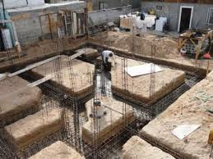
FOUNDATION

Slide 3
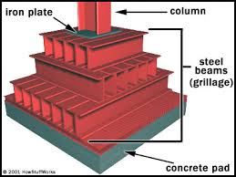
Types of foundation
1-shallow-
Spread footing,strap footing,combined footing,mat footing
Spread footing- for walls for columns
For walls - simple ,stepped, grillage
For columns - single, stepped,slopped
2-DEEP - pile,pier,well

Slide 4
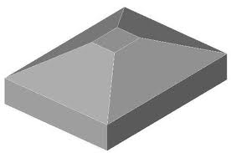
Spread footing
Those footing which spread the supper imposed load of wall or column over larger area.masonry walls have step footing with concrete base

Slide 5
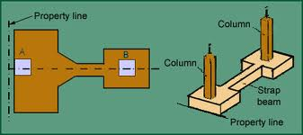
Strap footing
If independent footings of two columns are connected by beam is strap footing

Slide 6
Combined footing
A spread footing which supports two or more columns

Slide 7
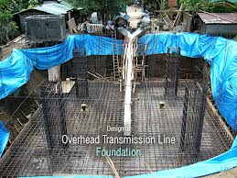
Grillage foundation
Grillage foundation is a special type of foundation where heavy loaded steel stanchions are used in these location where bearing capacity of soil is poor
Depth is from 1 to 1.5m
These foundation are generally used in industries

Slide 8
Walls
Walls are constructed as load bearng or non –load bearing just to enclose the space .
Walls are constructed of masonry.
Masonry is a construction of some solid blocks in the form of bricks , stones , building blocks etc .

Slide 9
Types of walls
Bearing walls
Non-bearing walls
Cavity walls
Curtain walls
Common walls
Partition walls

Slide 10
1) Bearing walls
A load-bearing wall (or bearing wall) is a wall that bears a load resting upon it by conducting its weight to a foundation structure. The materials most often used to construct load-bearing walls in large buildings are concrete, block, or brick.

Slide 11
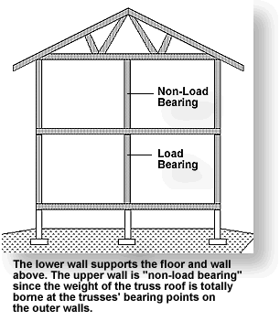
2)Non bearing walls
The nonbearing wall appears only where loads are carried by other members, as in heavy timber and other skeletal structures.
Modern steel and reinforced-concrete frames require exterior walls only for shelter and sometimes dispense with them on the ground floor to permit easier access. Since the wall rests or hangs upon members of the frame, it becomes...

Slide 12
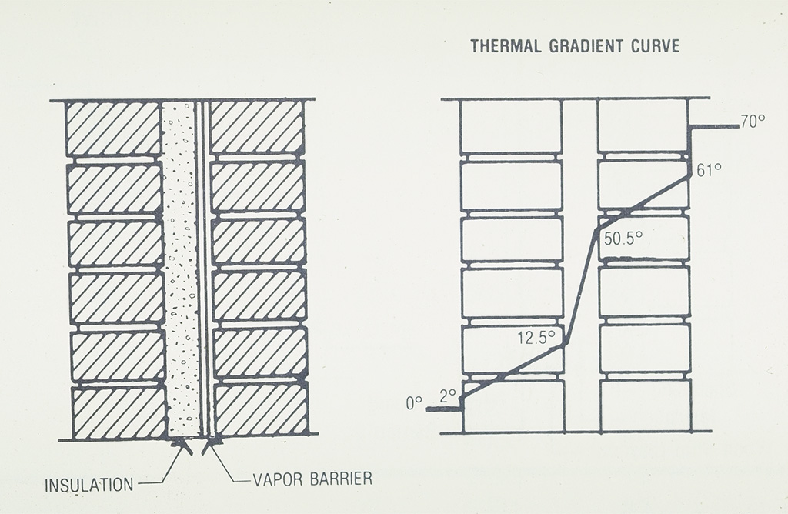
3) Cavity walls
Cavity walls consist of two 'skins' separated by a hollow space (cavity). The skins are commonly masonry such as brick or concrete block. Masonry is an absorbent material, and therefore will slowly draw rainwater or even humidity into the wall. The cavity serves as a way to drain this water back out through weep holes at the base of the wall system or above windows

Slide 13
4)Curtain walls
A curtain wall system is an outer covering of a building in which the outer walls are non-structural, but merely keep the weather out and the occupants in. As the curtain wall is non-structural it can be made of a lightweight material reducing construction costs.
Even glass can be used for cavity walls.

Slide 14
5.)Party or common walls
A party wall is a dividing partition between two adjoining buildings (or units) that is shared by the tenants of each residence or business. When built for this purpose, the builder will lay the wall along a property line dividing two terraced flats or row houses, so that one half of the wall's thickness lies on each property.

Slide 15
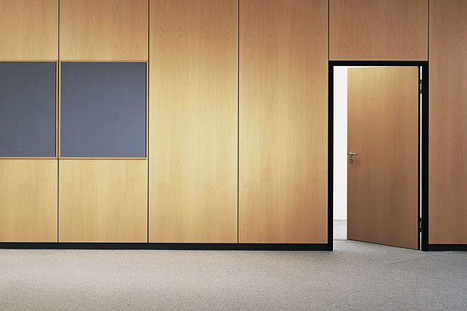
6) Partition wall
A partition wall is a wall for the purpose of separating rooms, or dividing a room. Partition walls are usually not load-bearing.

Slide 16
Columns

Slide 17
Columns -- Column or pillar in architecture and structural engineering is a structural element that transmits, through compression, the weight of the structure above to other structural elements below.
The term column applies especially to a large round support with a capital and base and made of stone, or appearing to be so. A small wooden or metal support is typically called a post, and supports with a rectangular or other non-round section are usually called piers

Slide 18
Plinth
Plinth is the part of structure between the surrounding ground surface and floor surface immediately above the ground .
Plinth is provided with dpc. The plinth is assists in transmitting the load of structure to the foundation.
It protects the building from moisture.
It prevents entry of rain water , dust, insects etc in building.

Slide 19
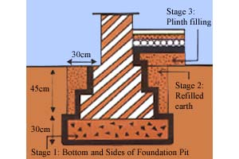

Slide 20
Cupboard & shelves
Cupboards & shelves are built in items which are useful for various services in the building.

Slide 21
Cupboards
A cupboard is a type of storage cabinet, often made of wood, used indoors to store household objects such as food, crockery, and protect them from dust and dirt.
The term cupboard was originally used to describe an open-shelved side table for displaying plates, cups and saucers.

Slide 22
Cupboard

Slide 23
Shelves
A shelf is a flat horizontal plane which is used in a home, business, store, or elsewhere to hold items of value that are being displayed, stored, or offered for sale.
it can be part of a piece of furniture such as a cabinet, bookcase, some headboards, and so on.
They are provided at any convenient reachable height.
They are limited to maximum width of 45 cm.

Slide 24
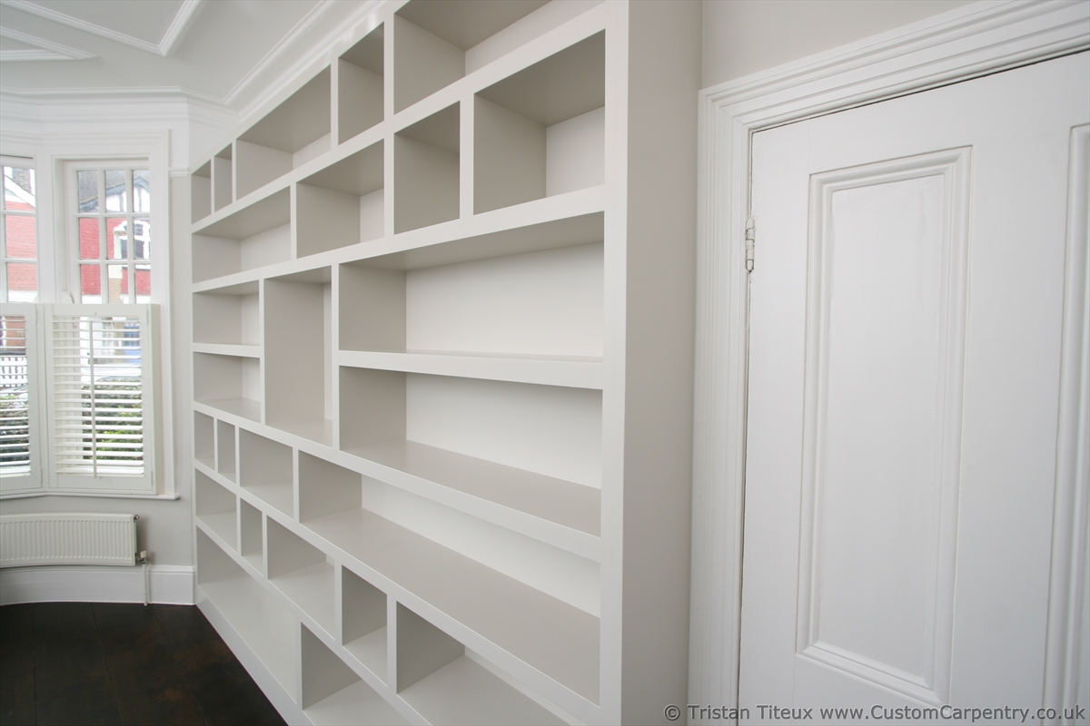
Shelves

Slide 25
Chajjas
Component of building which is placed over the opening to prevent adverse effect of weather on a room also wheathershed.
The purpose of chajja or sun shade is to prevent direct entry of sun light into the room to a certain extent
Also, it acts as a barrier to direct entry of rain water into the room through the opening.
It also adds on to the aesthetic appeal of a building.

Slide 26
Usually it is provided at a height of around 7 ft from floor level.
If its made of concrete, it is casted along with lintel monolithically.
An equal bearing of 9 inch-1ft has to be provided on both the sides of opening.
It can be either cast-in-situ or precast.
Their thickness tapers from 100 to 75 mm and projection is 30 , 45 , 60 , 75 , 90 cm .

Slide 27
Types of chajjas

Slide 28
Lintels
A lintel can be a load-bearing building component, a decorative architectural element, or a combined ornamented structural item.
It is often found over portals, doors, windows, and fireplaces.

Slide 29
Types of lintels
Stone lintel
Timber lintel

Slide 30
Brick lintel
Steel lintel

Slide 31
R.C.C. lintel

Slide 32
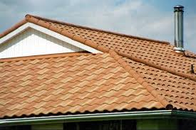
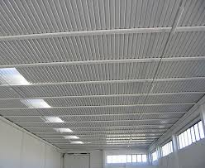
ROOF AND SLAB

Slide 33
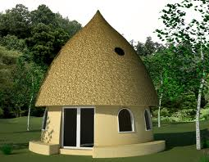
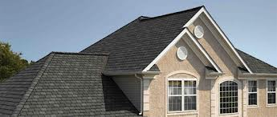
ROOF
ROOF:- The exterior surface and its supporting structures on the top of a building.
The upper exterior surface of a dwelling as a symbol of the home itself

Slide 34
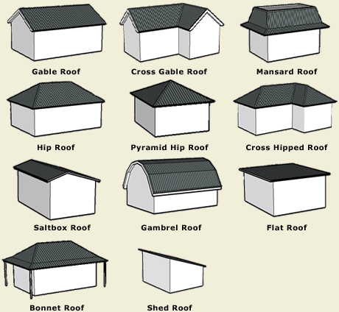
TYPES OF ROOF

Slide 35
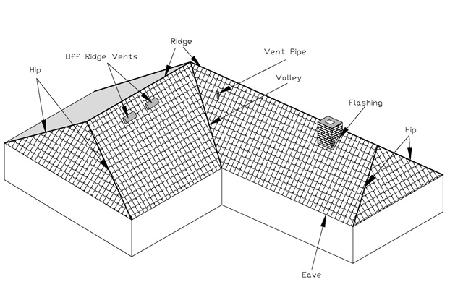
ELEMENTS OF ROOF

Slide 36
SLAB
A large, thick, flat piece of stone or concrete, typically square or rectangular in shape.
It’s a covering of building or provide encloser of building from uper side.
Slab is one type of roof called flat roof.
It’s made up from various materials like concrete, wood ,stone , lime.

Slide 37
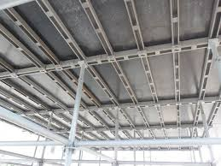

Slide 38
Stairs
Stairs:- It is comprised of series of steps to connect the different floors of a building
Basic type of stairs are:-
Straight stairs
Quarter turn stairs
Half turn stairs
Three quarter turn
Circular stairs
Spiral stairs
Curved stairs
Geometrical stairs
Bifurcated stairs

Slide 39
Images of different types of stairs
Straight staircase
Quarter turn staircase

Slide 40
Half turn staircase
Three quarter turn

Slide 41
Circular staircase
Spiral staircase

Slide 42
Curved stair case
Bifurcated staircase

Slide 43
Parapet
A parapet is a barrier which is an extension of the wall at the edge of a roof, terrace, balcony, or other structure
Main function of parapet is safety from falling down and it also gives a finishing touch to a structure

Slide 44
Parapet

Slide 45
Doors And Windows
Doors :- A door is an opening or closing structure used to block off an entrance, typically consisting of an interior side that faces the inside of a space and an exterior side that faces the outside of that space.
There are two types of doors:
1.Interior doors:- Primary function of interior doors is to provide privacy. They also serve decorative function. Interior door can be a simple flat panel door for a clean look or a raised panel door for a more elegant look. 2.Exterior doors:- The primary function of exterior doors is privacy by preventing unauthorized access to your house, and security by making it more difficult for intruders to get in.

Slide 46
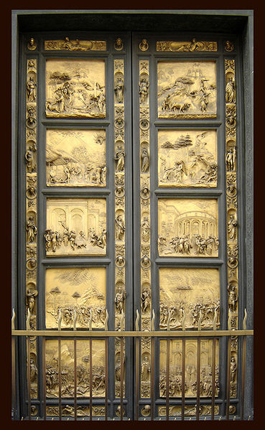
Images of doors

Slide 47
Functional features of doors are:
provide access to building or rooms
provide security by controlling access
provide privacy by separating rooms
provide a degree of sound insulation
provide fire separation between sections of the building
permit light to enter the hallway or room
provide thermal insulation from exterior, or between rooms.

Slide 48
Windows
A window is a transparent or translucent opening in a wall, door or vehicle that allows the passage of light and, if not closed or sealed, air and sound. Windows are usually glazed or covered in some other transparent or translucent material. Windows are held in place by frames. Many glazed windows may be opened, to allow ventilation, or closed, to exclude inclement weather

Slide 49
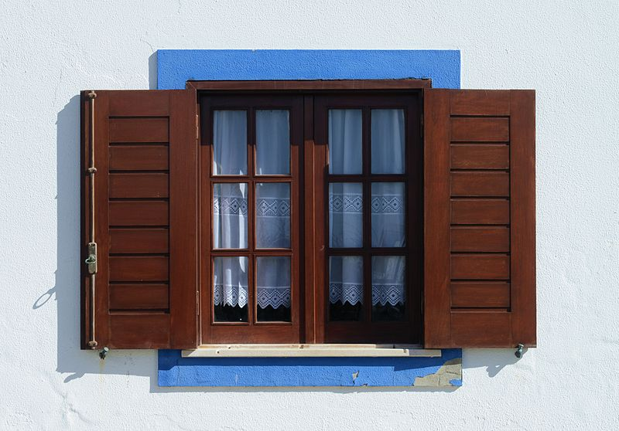
Picture of windows

